Slide 1
LEADERSHIP TRAINING FINANCE DIVISION
July 29, 2021

Slide 2
AGENDA
Navigate the departments within the Finance Division
Better understand the Finance Division expectations and requirements
Contact the appropriate employees within the Finance Division

Slide 3
FINANCE DIVISION TRAINING GOALS
 | Understand your Budget - Budget and Grants
 | Purchase Items - Procurement
 | Pay for Items - Accounts Payable
 | Pay Staff - Payroll
 | Make Sure Everything is Correct - Fiscal Control and Treasurer
 | It’s All Related! - Financial Systems

Slide 4
FINANCE DIVISION
Not sure which department to contact within the Finance Division?

Slide 5
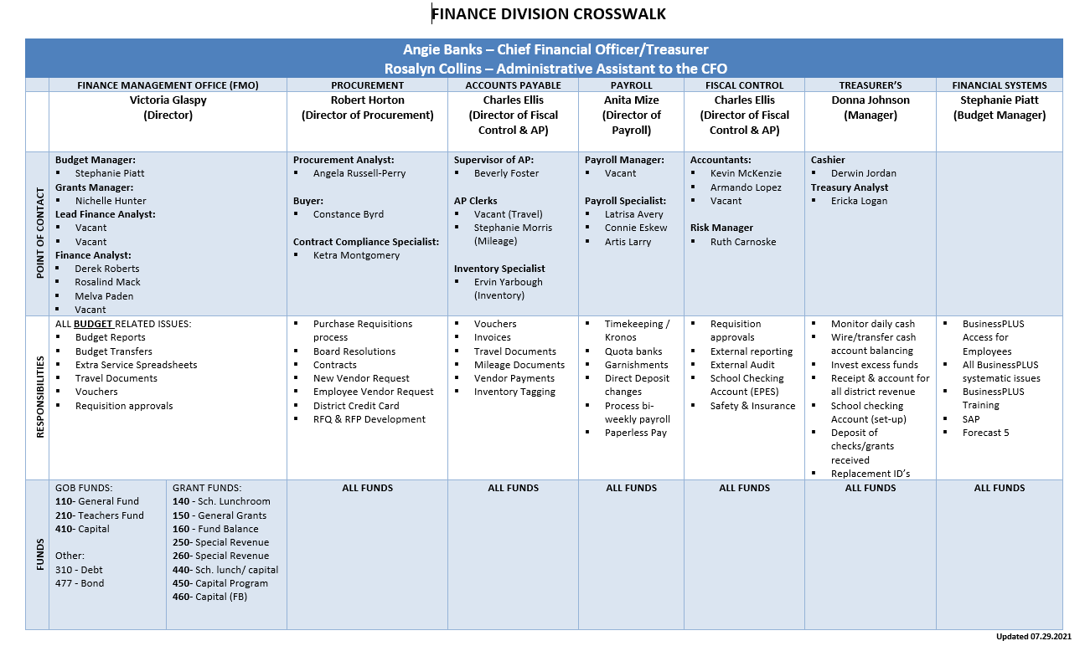
FINANCE DIVISION CROSSWALK

Slide 6
FINANCIAL MANAGEMENT OFFICE

Slide 7
FINANCIAL MANAGEMENT OFFICE
Finance Division
CFO
Angie Banks
Director of Financial Mgmt (FMO)
Victoria Glaspy
Budget Manager
Stephanie Piatt
Grants Manager
Nichelle Hunter

Slide 8
MEET THE TEAM
Victoria Glaspy Finance Director
Stephanie Piatt Budget Manager |  |  | Nichelle Hunter Grants Manager
Vacant Lead Finance Analyst | Rosalind Mack Finance Analyst | Melva Paden Finance Analyst | Vacant Lead Finance Analyst | Derek Roberts Finance Analyst | Shaun Hykes Finance Analyst
Clyde Miller Central VPA AESM Middle | Soldan Busch Gateway Middle Dewey Gateway Elem Hickey Hodgen Humboldt NAPAA Lexington Lyon Mann Shaw Sigel Washington Mont. | CSMB Metro McKinley Long Compton Drew Bryan Hill Buder Ames VPA Columbia Hamilton Henry Kennard Mallinckrodt Mason Oak Hill Stix Woerner Wilkinson Woodward | Gateway Nottingham CAJT Gateway Michael Mullanphy ETS@ Madison | Beaumont Carnahan Roosevelt Sumner Vashon Yeatmann Carr Lane Adams Ashland Berth Gilkey @ Cole Froebel Herzog Carver Jefferson Laclede Meramec Monroe Nance Peabody Shenandoah Walbridge | Griscom ICA @ Blewett Fresh Start

Slide 9
YOUR SCHOOL BUDGET
The Finance Management Office (FMO) Are Responsible For The Following:
Managing All Funds: General Operating Budget (GOB),Grants, Deseg/Expansion, Debt Service, and Capital Revenues and Expenditures
Staffing and Discretionary Budgets
Budget Transfers/Adjustments
Extra Service Spreadsheets and Pay Agreements

Slide 10
GENERAL OPERATING BUDGET
GOB
FUNDS
Fund 110
Fund 210
Fund 410
Purpose: Accounts for all transactions related to the operations of the District’s regular programs.
Purpose: Accounts for all transactions for salaries & benefits for teachers & and other certified staff.
Purpose: : Accounts for all transactions related to purchased services at the capital threshold amount.
Example:
Non-Certified Salaries & Benefits (excludes certified staff/teachers)
Purchased Services
Supplies & Materials
Equipment (e.g. computers below the capital threshold)
Example:
Certified Salaries & Benefits - Teachers
Extra Service for Teachers
Tuition Payments
Example:
Equipment (e.g. computers above the capital threshold)
Improvements and upgrade to facilities

Slide 11
GOB SCHOOL STAFFING
Certificated: Formula-driven model based on student enrollment, DESE Pupil Teacher Ratios, and District staffing ratios
principals, A/Ps, teachers, librarians, counselors, etc.
Non-Certificated: Formula-driven model based on student enrollment and District staffing ratios
secretaries, teacher aides, ISS monitors, etc.
Staffing budgets and expenditures are not available on the school budget report - BusinessPLUS GL5000
Notes:
Our next steps include public forums for community input and/or feedback in addition to the online public comment period. We will make any necessary budget updates, present the proposed budgets and anticipate approval.

Slide 12
DISCRETIONARY BUDGET
Discretionary budgets and expenditures are available in school budget report - BusinessPLUS GL5000
Allocations are based on student enrollment
Principals manage funds to purchase items needed for their school including supplies, technology, extra service, etc.
Notes:
Our next steps include public forums for community input and/or feedback in addition to the online public comment period. We will make any necessary budget updates, present the proposed budgets and anticipate approval.

Slide 13
BUDGET TRANSFERS
Transfers from one account to another may be requested if additional funds are needed for a specific purchase
Example: transfer $500 from supplies account to extra service account for additional afterschool tutoring

Slide 14
EXTRA SERVICE
Extra service is how certificated staff are paid for time worked outside of the normal workday or contract dates
Schools submit Extra service time on a budget office spreadsheet
A signed pay agreement accompanies the extra service
Kronos and extra service training will be provided will be provided by Payroll as needed

Slide 15
EXPENDITURES: BUSINESS PLUS
District account structure:
Fund 110 = general
Function 1111 = elementary instruction
Object 641101 = supplies
Location 4000 = Adams Elementary School
Project 000000 = N/A
For detailed description of the District account structure visit: BusinessPLUS Finance Division Training Manual
School Type | FUND | FUNCTION | OBJECT | LOCATION | PROJECT | FISCAL YEAR
Elementary | 110 | 1111 | 641101 | 4000 | 000000 | 00
Middle | 210 | 1131 | 613101 | 3140 | 000000 | 00
High | 410 | 1151 | 654101 | 1220 | 500990 | 00
Alternative | 110 | 1193 | 641202 | 6920 | 000000 | 00

Slide 16
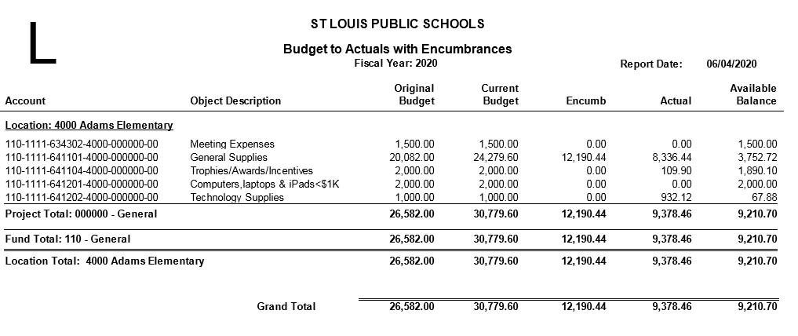
BUSINESS PLUS GL5000
Fund | Function | Object | Location | Project | Fiscal Year
110 | 1111 | 634302 | 4000 | 000000 | 00
Object Description: This object code is a 6 digit number that describes the type of expenditure e.g. 641101- supplies
Original Budget: This represents the adopted original budget that was approved by the board
Current Budget: This represents adjustments to the original budget e.g. budget transfers, etc.
Ecumb (Encumbrances): A dollar amount held (committed) to pay for goods or services.
Actual: shows the dollar amount that was actually paid from your budget
Available Balance: indicates the dollar amount available to spend. Current Budget minus Encumbrances/Actuals = Available Balance

Slide 17
GRANT FUNDS
GRANT FUNDS
Incidental Funds 140,150,160
Certificated Funds 250, 260
Capital Funds 440, 450, 460
Purpose: Accounts for all transactions related to regular supplemental operations.
Purpose: Accounts for all transactions for salaries & benefits for teachers & and other certified staff.
Purpose: : Accounts for all transactions related to purchased services at the capital threshold amount.
Example:
Non-Certified Salaries & Benefits
FCS, PBIS, Intervention Specialist
Contractual Services
PD for teachers (631201)
Transportation (634201)
Supplies & Materials
General Supplies (641101), Computers less than 1K per item (641201) Software Licenses less than 5K (641202)
Example:
Certified Salaries & Benefits – Teachers
AICs, Supplemental Math or Reading Teachers
Extra Service for Teachers for Extended Day and Tutoring (613101), or Professional Development (613102).
Example:
Classroom Equipment (654301)
Items that are more than $1,000 per Item
(Examples, are iPad Carts, Smart Boards, Promethean Boards)
Software Licenses more than $5,000 (654401)

Slide 18
TITLE I - PART A, SCHOOLWIDE
Title I-Part A funds should be used to upgrade the entire educational program in a school so that all students may benefit from the use of these funds. Activities must be a part of the schoolwide plan and support an identified academic need through the school’s comprehensive needs assessment.

Slide 19
TITLE I.A : ALLOWABLE EXPENSES
Academic Support
Before, After, and Saturday School Tutoring
Credit recovery, academic acceleration, and courses that lead to diploma
Materials, Supplies, and Equipment
Computer-aided instruction software
Supplemental instructional materials,
Technology Items (iPads, Laptops, Desktops)
Software for supplemental instruction
Periodicals
Online subscriptions

Slide 20
PARENTAL INVOLVEMENT ALLOWABLE EXPENSES
Family Community Specialist
Parent training
Guest speakers
Supplies for literacy/math night
Printing, binding, publishing services for distribution of materials to parents
Activities and supplies to support parent meetings
Light refreshments to support meetings and attendees

Slide 21
EXTRA SERVICE AND PAY AGREEMENTS
Any activity that is supplemental in nature can be paid for with grant funds
To have Extra Service processed, You must submit the following:
Extra Service Spreadsheet
Extra Service Pay Agreement
Detailed extra service training will be provided at the June 17-18 administrator training and individually by Payroll

Slide 22
FINANCIAL MANAGEMENT STAFF
Contact Information:
Victoria Glaspy, Director of Financial Managment Phone: 633-5310
Victoria.Glaspy@slps.org
Nichelle Hunter, Grants Manager Phone: 345-2474
Nichelle.Hunter@slps.org
Stephanie Piatt, Budget Manager Phone: 345-2231 Stephanie.Piatt@slps.org
Derek Roberts, Finance Analyst Phone: 633-5425
Derek.Roberts@slps.org

Slide 23
FINANCIAL MANAGEMENT STAFF
Contact Information:
Vacant, Finance Analyst Phone: 345-2259
Shaun.Hykes@slps.org
Rosalind Mack, Finance Analyst Phone: 345-2262
Rosalind.Mack@slps.org
Melva Paden, Finance Analyst Phone: 345-4425
Melva.Paden@slps.org
Vacant, Lead Finance Analyst Phone: 345-xxxx
Vacant@slps.org
Vacant, Lead Finance Analyst Phone: 345-xxxx
Vacant@slps.org

Slide 24
FINANCIAL MANAGEMENT OFFICE
Questions???
Don’t remember what we just covered??
Our page may have the answer for you. Visit our webpage at
https://www.slps.org/Page/111

Slide 25
PROCUREMENT OFFICE

Slide 26
PROCUREMENT OFFICE
Finance Division
CFO
Angie Banks
Director of Procurement
Robert Horton
Sr. Procurement Analyst
Angela Russell-Perry
Buyer II Constance Byrd
Contract Compliance Specialist Ketra Montgomery

Slide 27
MEET THE PROCUREMENT TEAM
POINT OF CONTACT | Robert Horton Director of Procurement Robert.Horton@slps.org 314-345-2380 | Angela Russell-Perry Sr. Procurement Analyst Angela.Russell-Perry@slps.org 314-345-2390 | Constance Byrd Buyer II Constance.Byrd@slps.org 314-345-2255 | Ketra Montgomery Contract Compliance Specialist Ketra.Montgomery@slps.org 314-345-2495
RESPONSIBILITIES | RFP/Contracts Human Resources Food and Nutrition Services Grants Procurement Compliance Contract Renewal | Vendor Management RFP/Contracts Academics Sunshine Request Public Information Budget Office Office of Institutional Advancement Contract Renewal Supplier Diversity | Bus Passes Employee Vendor Management Requisition Assistance Purchase Order Shipping Liaison | RFP/Contracts Board Docs/Resolutions Contract Management Spreadsheet Facilities Communications Transportation Information Technology

Slide 28
PROCUREMENT OVERVIEW
Procurement is responsible for:
Compliant Procurement policies and adherence to procedures in the SLPS Board Approved Procurement Manual
Competitive Bidding/Request for Proposal (RFP) process
Vendors management: pricing, delivery and invoicing concerns
Procure the right goods and services, from the right source, at the right cost, to the right place based on quality and quantities

Slide 29
PROCUREMENT PROCESS
School Identify Goods/Service Needs
Identify vendor
Identify Dollar Threshold
Create Requisition in BusinessPLUS
BusinessPLUS Approval Process
PO Generated in BusinessPLUS
PO emailed to vendor
School complete receiver on Purchase
Payment Process Three way match in System

Slide 30
THREE WAY MATCH
Purchase Order entered and approved in BusinessPLUS
Schools/Central Office enter “Receive on Purchase” in BusinessPLUS
Check sent to vendor
$ Check $
Invoice received and entered by SLPS Accounts Payable
If all of these steps are not completed, the vendors will not receive payment!

Slide 31
GOODS CONFIRMATION
Receive on Purchase Order in BusinessPLUS
Items ordered and received by the school must be confirmed
The “Receive on Purchase” transaction in BusinessPLUS is the school’s confirmation that all items requested via the Purchase Order have been received
If the “Receive on Purchase” transaction is not completed, Accounts Payable will not issue a vendor payment

Slide 32
DOLLAR VALUE THRESHOLDS
Dollar Value Threshold | Quote Requirement
$0 - $1,000
$1,001 - $4,999.99 | Two (2) vendor quotes (documented and attached in BusinessPLUS)
$5,000 - $14,999.99 | Three (3) vendor quotes (documented and attached in BusinessPLUS) Superintendents approval/Board approval
Over $15,000.00 | Must go through a formal bidding process (RFP,RFQ,ITB) Documented and attached in BusinessPLUS Superintendent’s approval and Board approval via Board Resolution

Slide 33
PREFERRED VENDORS
The District has negotiated fixed pricing for the following:
Product Category | Vendor Name | Vendor ID
COMPUTER & PERIPHERALS | DELL | 600005394
 | APPLE | 600011766
INTERACTIVE BOARDS | TSI | 600005437
 | Haddock | 600013273
COPY PAPER | Office Essentials | 600010887
 | The Saunders Company | 600016276
SCHOOL SUPPLIES | Office Essentials | 600010887
 | School Specialty | 600001131
 | Lakeshore Learning | 600000098

Slide 34
BOARD RESOLUTIONS
Purchases between $5000 and $14,999.99
All recommendations for purchases between$5,000 and $14,999.99 requires Superintendent’s approval and may require Board approval via Board Resolution unless included on the Authorized Exclusion List
Board Resolution is required on all purchases or services $15,000.00 and greater.
Include:
Dates of service
Vendor/Provider
Total value of goods or services
Funding source e.g. (110-2411-641101-1234-000000-00)
Contract Purchase number (e.g. CXXXXXX)
Answer background questions via Board Resolution Form
Contact: Ketra.Montgomery@slps.org

Slide 35
PROCUREMENT STAFF
Contact Information:
Robert Horton, Director of Procurement Phone: 345-2380
Robert.Horton@slps.org
Angela Russell-Perry, Procurement Analyst Phone: 345-2298
Angela Russell-Perry@slps.org
Constance Byrd, Buyer Phone: 345-2255
Constance.Byrd@slps.org
Ketra Montgomery, Contract Specialist Phone: 345-2495
Ketra.Montgomery@slps.org

Slide 36
PROCUREMENT OFFICE
Questions???
Don’t remember what we just covered??
Our page may have the answer for you. Visit our webpage at
https://www.slps.org/Page/1131

Slide 37
ACCOUNTS PAYABLE
Accounts Payable

Slide 38
ACCOUNTS PAYABLE
Fiscal Control Department Fiscal Control Director
Charles Ellis
Accts Payable Supervisor
Beverly Foster
AP/Prop Clerk
Vacant
Property Control Tech
Ervin Yarbough
AP/Prop Clerk
Stephanie Morris
Property Control Tech
Vacant

Slide 39
ACCOUNTS PAYABLE OVERVIEW
 | Processing vendor payments for goods and services. All Vendor invoices must be sent to AccountsPayable@slps.org Vendor checks are processed every Tuesday
 | Issuing reimbursement via voucher to employees for misc. supplies, meeting expenses, travel and mileage. Voucher procedures and forms can be found: https://www.slps.org/Page/122
 | Processing District employee’s out of town travel advances. Travel forms: https://www.slps.org/Page/122
 | Performing inventory site visits for school property
 | Maintaining all school district property records
Contact Beverly Foster, Accounts Payable Supervisor
Beverly.Foster@slps.org
345-2493

Slide 40
ACCOUNTS PAYABLE STAFF
Contact Information:
Beverly Foster, Accounts Payable Supervisor Phone: 345-2493
Beverly.Foster@slps.org
Stephanie Morris, Accounts Payable Clerk Phone: 345-2278
Stephanie.Morris@slps.org
Vacant, Accounts Payable Clerk Phone: 345-2340

Slide 41
ACCOUNTS PAYABLE STAFF
Contact Information:
Vacant, Property Technician Phone: 345-2625
Ervin Yarbough, Property Technician Phone: 231-3720
Ervin.Yarbough@slps.org

Slide 42
PAYROLL OFFICE

Slide 43
PAYROLL OFFICE
Finance Division
CFO
Angie Banks
Payroll Specialist
Artis Larry
Director of Payroll
Anita Mize
Payroll Specialist
Connie Eskew
Payroll Manager Vacant
Payroll Specialist
Latrisa Avery

Slide 44
PAYROLL OFFICE OVERVIEW
The Payroll Office is responsible for:
Timely and accurate completion of bi-weekly payroll
Resolving payroll related questions

Slide 45
TIMEKEEPING
Provide training and support for Kronos
Kronos tracks employee attendance
Contact Anita Mize Anita.Mize@slps.org to schedule one on one training
SLPS employees are required to clock in and out daily
Assistance with Kronos license or access contact
Cheryll Saunier: Email: Cheryll.Saunier@slps.org

Slide 46
OVERTIME
The federal overtime provisions are contained in the Fair Labor Standards Act (FLSA). Unless exempt, employees covered by the Act must receive overtime pay for hours worked over 40 in a workweek at a rate not less than time and one-half their regular rates of pay. There is no limit in the Act on the number of hours employees aged 16 and older may work in any workweek. The Act does not require overtime pay for work on Saturdays, Sundays, holidays, or regular days of rest, unless overtime is worked on such days.
The Act applies on a workweek basis. An employee's workweek is a fixed and regularly recurring period of 168 hours — seven consecutive 24-hour periods. It need not coincide with the calendar week, but may begin on any day and at any hour of the day. Different workweeks may be established for different employees or groups of employees. Averaging of hours over two or more weeks is not permitted. Normally, overtime pay earned in a particular workweek must be paid on the regular pay day for the pay period in which the wages were earned.

Slide 47
EXTRA SERVICE
Extra Service is designed to pay our certified exempt teachers for additional duties outside of their normal work schedule
Non-exempt employees are not eligible for extra service

Slide 48
ESCROW ACCOUNT
Non 12 month staff may participate in our escrow program
Escrow enrollment cards will be distributed in September, expected to receive email invitation to enroll
Return escrow enrollment cards to the Payroll Office by deadline
The deduction schedule: 16 bi-weekly deductions. This is a non-interest-bearing account.
Five reimbursements over the summer:
Two in June
Two in July
Final payment in August
The reimbursements have no tax impact to employees!

Slide 49
WITHHOLDING FORM W-4
Incorrect forms will be rejected
Employee’s withholding status will remain as single (or last W-4, Mo-4 form on file) until a corrected form is submitted
Utilize W-4 worksheet for guidance and keep copy for your records
Payroll can assist with questions but cannot provide tax advice
Employee’s must use current year tax forms

Slide 50
GARNISHMENTS
Employee questions related to a garnishment on their pay check:
Contact: Artis Larry in the Payroll Office
Artis.Larry@slps.org
Phone: 314-345-2235
If you receive a court ordered garnishment at your location:
Send to Payroll Office via inner office mail
Attn: Artis Larry
If your school receives a garnishment refund check:
Do not deposit into Student Activity Bank Account!
Send check to the Payroll Office via inner office mail.
Attn: Artis Larry

Slide 51
PAYROLL OFFICE STAFF
Contact Information:
Anita Mize, Director of Payroll Phone: 345-2291
Anita.Mize@slps.org
Vacant, Payroll Manager Phone: 345-xxxx
Latrisa Avery, Payroll Specialist Phone: 345-2284
Latrisa.Avery@slps.org
Connie Eskew, Payroll Specialist Phone: 345-2417
Connie.Eskew@slps.org
Artis Larry, Payroll Specialist Phone: 345-2235
Artis.Larry@slps.org

Slide 52
PAYROLL OFFICE
Questions???
Don’t remember what we just covered??
Our page may have the answer for you. Visit our webpage at
https://www.slps.org/Page/117

Slide 53
FISCAL CONTROL

Slide 54
FISCAL CONTROL OFFICE
Finance Division
CFO
Angie Banks
Fiscal Control Department Fiscal Control Director
Charles Ellis
Accountant III
Armando Lopez
Accountant III Kevin McKenzie
Inventory Control Technician
Ervin Yarbough

Slide 55
FISCAL CONTROL OVERVIEW
Fiscal Control responsibilities:
Enforce financial policies
Prepare finance reports for State and Federal agencies
Process and approve purchase requisitions in BusinessPLUS
Monitor student activity accounts (EPES software)
Maintaining all district school property records
Performing inventory site visits for school property

Slide 56
STUDENT ACTIVITY ACCOUNTS
EPES software is used to track, record and report on student activity fund transactions from payment to reconciliation
Schools reconcile bank accounts in the EPES software
Funds are used only for students (Band, Graduation, etc.)
Expenses related to staff and school personnel must be paid from a non-student related account also identified in EPES (i.e. though vending commissions)
School personnel enter account data on a weekly basis and perform monthly bank reconciliations, while the Fiscal Control department monitors and reviews them
 | t

Slide 57
INVENTORY PROCEDURES
The Principal/Director of each school/site is ULTIMATELY responsible for safeguarding ALL SLPS assets and/or equipment at their school. They can designate appropriate employees to ensure that assets are properly maintained, properly controlled, and its location known at all times.
Contact the Inventory Control Technician to have a physical inventory done every year
When property is shipped directly to you, contact us immediately, to schedule a date to affix tags. Always remember to add the inventory information to your Inventory Sheet
 | t

Slide 58
LOST, MISSING or MOVED ITEMS?
Complete and submit these forms to our department as needed:
Item missing and its location is unknown - Missing equipment form (M-01)
Item stolen - SLPS Police Report Form (IN-22)
Item sent to another location - a transfer form (SD-107)
Item sent out for repair - a transfer form (SD-107)
Any equipment loaned out to teacher or staff - Short/Long Term Equipment Check-Out Form.
 | t

Slide 59
FISCAL CONTROL STAFF
Contact Information:
Charles Ellis, Director Phone: 345-2389
Ronnie.Martindale@slps.org
Kevin McKenzie, Accountant III Phone: 345-2275
Kevin.McKenzie@slps.org
Armando Lopez, Accountant III Phone: 345-2274
Armando.Lopez@slps.org
Ervin Yarbough, Property Technician Phone: 345-2297
Ervin.Yarbough@slps.org

Slide 60
RISK MANAGEMENT

Slide 61
RISK MANAGEMENT OFFICE
Finance Division
CFO
Angie Banks
Fiscal Control Department Fiscal Control Director
Charles Ellis
Risk Manager
Ruth Carnoske

Slide 62
RISK MANAGEMENT OVERVIEW
Risk Management is responsible for:
Reducing District risk with insurance products
Implementing safety programs and training (Safe Schools)
Evaluating employee injury and accident trends
Implementing corrective measures to reduce costs
Contact Ruth Carnoske, Risk Manager
Ruth.Carnoske@slps.org
345-2397

Slide 63
FISCAL CONTROL
Questions???
Don’t remember what we just covered??
Our page may have the answer for you. Visit our webpage at
https://www.slps.org/Page/122

Slide 64
TREASURER’S OFFICE

Slide 65
TREASURER’S OFFICE
Finance Division
CFO
Angie Banks
Treasurer’s Office
Manager
Donna Johnson
Treasury Analyst
Ericka Logan
Cashier
Derwin Jordan

Slide 66
TREASURER’S OFFICE OVERVIEW
Monitor daily cash
Invest excess funds
Receipt & account for all district revenue
Assist schools with opening or closing bank accounts and general account maintenance

Slide 67
SCHOOL CHECKING ACCOUNTS
All school accounts must be with US Bank. The Treasurer’s Office can assist schools with the following:
Opening new accounts
Adding new principals as signers on accounts
Adding or deleting existing signers
Completing bank forms to make changes. School personnel should not contact the bank directly for these services.
Before writing checks, make sure you have available funds!

Slide 68
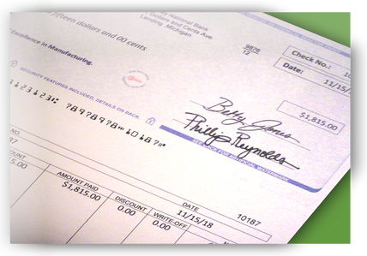
SCHOOL CHECKING ACCOUNTS
Two signers are required on bank accounts
Two signatures are required on each check written
Email Donna.Johnson@slps.org with questions
Signer 1 & Signer 2

Slide 69
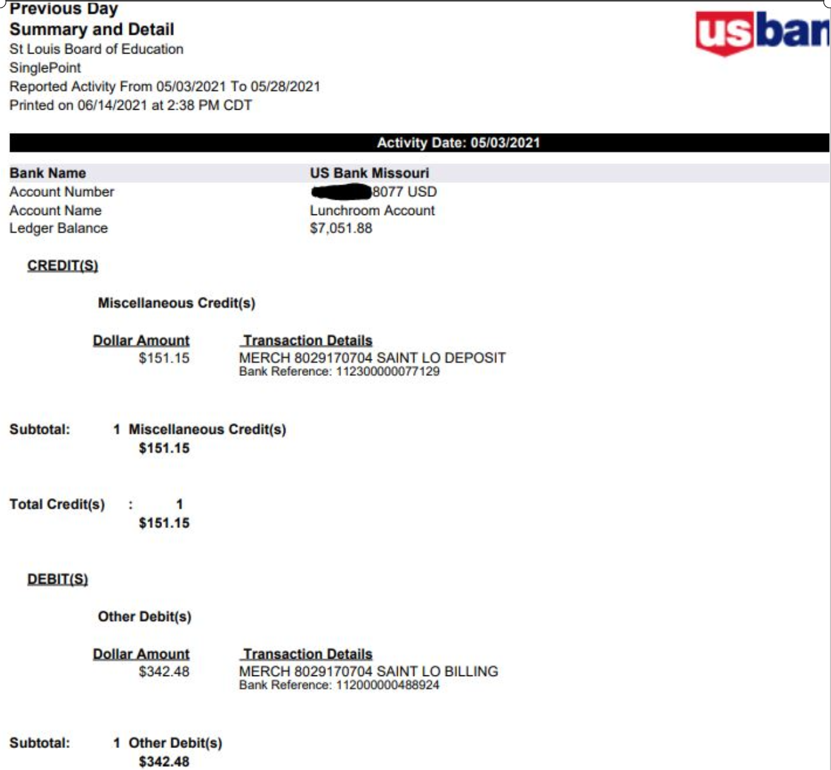
SCHOOL SINGLEPOINT ACCESS

Slide 70
TREASURER’S STAFF
Contact Information:
Donna Johnson, Manager Phone: 345-2290
Donna.Johnson@slps.org
Ericka Logan, Treasury Analyst Phone: 345-2232
Ericka.Logan@slps.org
Derwin Jordan, Cashier Phone: 345-2232
Derwin.Jordan@slps.org

Slide 71
TREASURER’S OFFICE
Questions???
Don’t remember what we just covered??
Our page may have the answer for you. Visit our webpage at
https://www.slps.org/Page/116

Slide 72
Large image
Finance Division Websites & Additional Resources

Slide 73
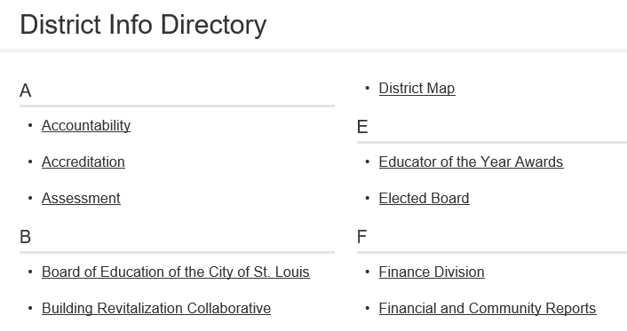
FINANCE DIVISION WEBSITES
From the district page, click on “District Info”
Click on “Finance Division”
Click on “applicable office within Finance”

Slide 74
FINANCIAL SYSTEM

Slide 75
BUSINESS PLUS FINANCIAL SYSTEM
What is BusinessPLUS?
BusinessPLUS is the official Financial system of the District
The system tracks all budgetary and financial information
How to gain access to BusinessPLUS
Download and complete form on website “BusinessPLUS Access Request Form” https://www.slps.org/Page/23540
Email completed form to: BusinessPLUShelp@slps.org

Slide 76
BUSINESS PLUS FINANCIAL SYSTEM
Logging into BusinessPLUS:
http://bp.slps.org/ifas7/home(Internet Explorer only)
Locked out of BusinessPLUS?:
Contact the District’s helpdesk at 345-5757 or helpdesk@slps.org
Budget Reports & Transactions:
GL_5000: Budget to Actual Report
Create Budget Transfer - GLBUBAUB
Procurement Reports & Transactions:
PO3001: Purchase Order Status Inquiry Report
Enter Purchase Requisition – POUPPR
Create Contracts & Amendments – CMUPCM
Receive on Purchase Order – POUPRC
Schedule one-on-one BusinessPLUS Training
Contact Stephanie.Piatt@slps.org

Slide 77
BUSINESS PLUS FINANCIAL SYSTEM
Log into BusinessPLUS:
http://bp.slps.org/ifas7/home(Internet Explorer only)
Access GL5000: Budget to Actual Report:
Confirm your current budget allocation and determine where you would like to move budget
Enter Blanket Requisition for transportation (field trips):
https://youtu.be/kkaqoa9rbIk

Slide 78
BUSINESS PLUS FINANCIAL SYSTEM
Questions???
Don’t remember what we just covered??
Our page may have the answer for you. Visit our webpage at
https://www.slps.org/Page/23540

Slide 79
THANK YOU
SLPS Finance Division

